Slide 1



Movies Budget and Revenue
View in Power BI
Last data refresh:
8/17/2023 1:42:59 AM UTC
Downloaded at:
8/17/2023 1:44:46 AM UTC

Slide 2
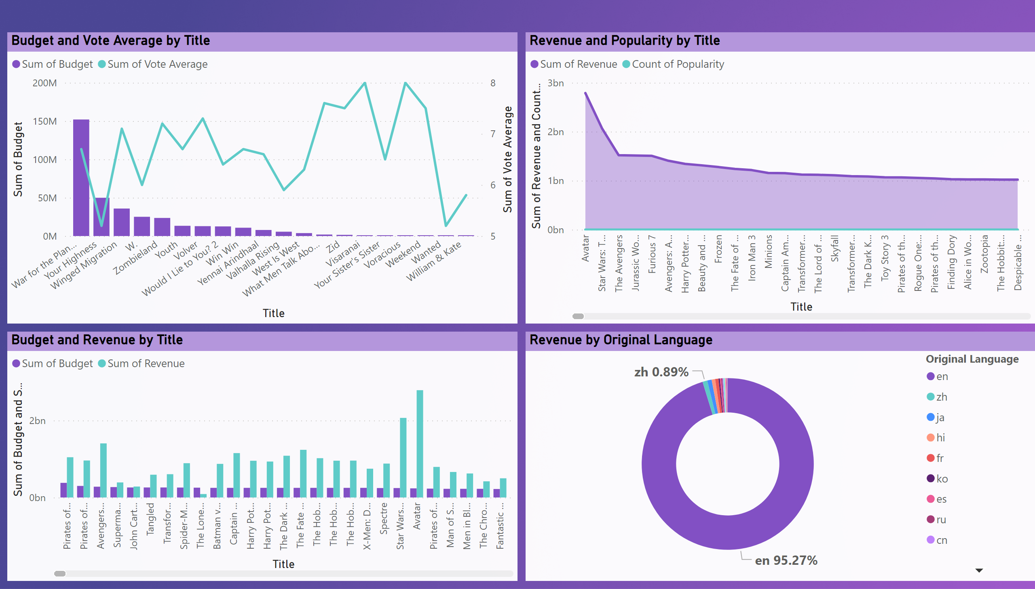
Page 4
Notes:
Budget and Vote Average by Title
No alt text provided
Budget and Revenue by Title
No alt text provided
Revenue and Popularity by Title
No alt text provided
Revenue by Original Language
No alt text provided

